Slide 1

Prediction of Bike Share Demand
-EL-GY 9123 Introduction to Machine Learning Final Project
Hongyi Sun(hs3497) Qiongxuan Tan(qt310)
Date: 05/16/2018

Slide 2
Project Abstract:
With the popularity of shared bike in big cities like San Francisco, it is becoming more and more important to predict the real demand of shared bike based on previous data.
We try to predict the daily demand of shared bike and duration of each trip based on several weather and date features.
Since there are several features and targets, we consider it as a multi-regression problem.
We got data from Kaggle.com[1] and try to fit it in models we learned in class, such as linear regression, LASSO regression, and neural network. We compare the accuracies of different models to get the optimized solution. After getting different accuracies from these models, we will discuss how to improve it in future work
[1] https://www.kaggle.com/benhamner/sf-bay-area-bike-share

Slide 3
Project Abstract:
1
Linear Regression
Multi-Regression Problem
2
LASSO Regression
3
Neural Network

Slide 4
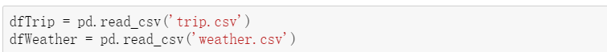
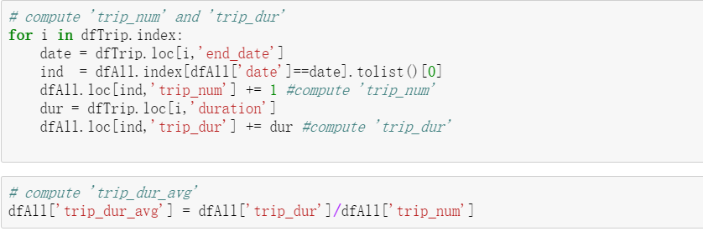
Project Abstract:
Selection of features and targets
Read data from trip.csv and weather.csv.
2. Compute the daily trip numbers and average durations. In this step, we explore end date of each trip, count all trips with same end date as daily trip number, and use mean of their durations as average trip duration.

Slide 5
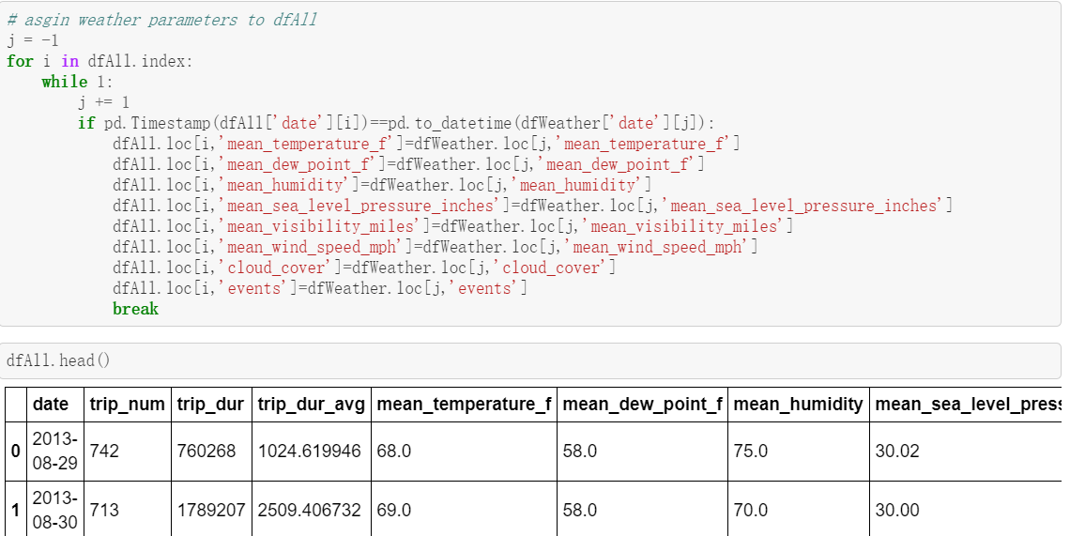
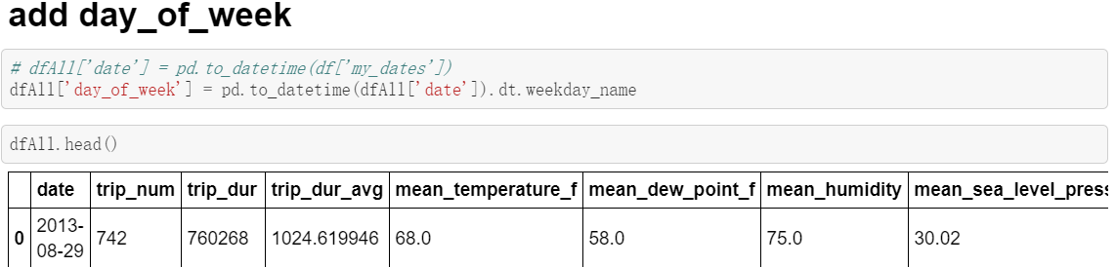
Project Abstract:
Selection of features and targets
Match weather parameters with daily trip parameters. In this step, we choose weather features like temperature, dew point, humidity, sea level, visibility, wind speed, cloud cover and events
We also add the day of week feature by common sense since it is supposed to have difference demands between workdays and weekends.

Slide 6
Project Abstract:
Selection of features and targets
Features:
date, mean_temperature_f, mean_dew_point_f,
mean_humidity, mean_sea_level_pressure_inches, mean_visibility_miles, mean_wind_speed_mph, cloud_cover, events
Targets:
trip_num, trip_dur_avg

Slide 7
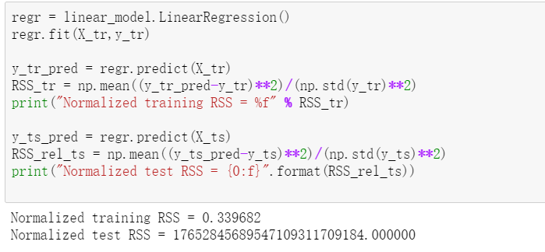
Linear Regression:

Slide 8
LASSO Regression:
Selection of features and targets
Features:
date, mean_temperature_f, mean_dew_point_f,
mean_humidity, mean_sea_level_pressure_inches, mean_visibility_miles, mean_wind_speed_mph,
precipitation_inches, cloud_cover, events
Targets:
trip_num, trip_dur_avg

Slide 9
Neural Network:
Selection of features and targets
Features:
date, mean_temperature_f, mean_dew_point_f,
mean_humidity, mean_sea_level_pressure_inches, mean_visibility_miles, mean_wind_speed_mph,
precipitation_inches, cloud_cover, events
Targets:
trip_num, trip_dur_avg

Slide 10
Neural Network:
Selection of features and targets
Features:
date, mean_temperature_f, mean_dew_point_f,
mean_humidity, mean_sea_level_pressure_inches, mean_visibility_miles, mean_wind_speed_mph,
precipitation_inches, cloud_cover, events
Targets:
trip_num, trip_dur_avg

Slide 11
Conclusion:
We performed linear and neural network regression to predict the demand for bikes at bike share stations, as a function of time, day of week, temperature, and precipitation, and to predict the duration of bike trips as a function of age and gender of customer. We see that the duration prediction has a good t of training data and small generalization error, but prediction of number of trips seems to yield periodically increasing loss, which is something that should be addressed in future work.

Slide 12
Future Work:
We performed linear and neural network regression to predict the demand for bikes at bike share stations, as a function of time, day of week, temperature, and precipitation, and to predict the duration of bike trips as a function of age and gender of customer. We see that the duration prediction has a good t of training data and small generalization error, but prediction of number of trips seems to yield periodically increasing loss, which is something that should be addressed in future work.

Slide 13
单击添加标题
点击此处添加标题
单击此处输入文本，单击此处输入文本，单击此处输入文本
点击此处添加标题
点击此处添加标题
单击此处输入文本，单击此处输入文本，单击此处输入文本
单击此处输入文本，单击此处输入文本，单击此处输入文本
点击此处添加标题
点击此处添加标题
单击此处输入文本，单击此处输入文本，单击此处输入文本
单击此处输入文本，单击此处输入文本，单击此处输入文本

Slide 14
单击添加标题
关键词
关键词
在此输入相关文字，在此输入相关文字，在此输入相关文字在此输入相关文字，在此输入相关文字，在此输入相关文字，
在此输入相关文字，在此输入相关文字，在此输入相关文字在此输入相关文字，在此输入相关文字，在此输入相关文字，
关键词
关键词
在此输入相关文字，在此输入相关文字，在此输入相关文字在此输入相关文字，在此输入相关文字，在此输入相关文字，
在此输入相关文字，在此输入相关文字，在此输入相关文字在此输入相关文字，在此输入相关文字，在此输入相关文字，

Slide 15
单击添加标题
点击添加标题
点击添加标题
在此输入相关文字，在此输入相关文字，在此输入相关文字， 在此输入相关文字，
在此输入相关文字，在此输入相关文字，在此输入相关文字， 在此输入相关文字，
步骤一
步骤二
步骤三
步骤四
点击添加标题
点击添加标题
在此输入相关文字，在此输入相关文字，在此输入相关文字， 在此输入相关文字，
在此输入相关文字，在此输入相关文字，在此输入相关文字， 在此输入相关文字，

Slide 16

03
PART
研究成果与应用
在此输入相关文字，DOCER稻壳儿设计师qzuser，更多精品模板http://chn.docer.com/works?userid=310034636。

Slide 17
单击添加标题
添加标题
添加标题
70%
在此输入相关文字，在此输入相关文字，在此输入相关文字， 在此输入相关文字，
在此输入相关文字，在此输入相关文字，在此输入相关文字， 在此输入相关文字，
30%
在此输入相关文字，在此输入相关文字，在此输入相关文字， 在此输入相关文字，
添加标题
在此输入相关文字，在此输入相关文字，在此输入相关文字， 在此输入相关文字，
在此输入相关文字，在此输入相关文字，在此输入相关文字， 在此输入相关文字，
添加标题
40%
60%
添加标题
在此输入相关文字，在此输入相关文字，在此输入相关文字， 在此输入相关文字，
在此输入相关文字，在此输入相关文字，在此输入相关文字， 在此输入相关文字，
在此输入相关文字，在此输入相关文字，在此输入相关文字， 在此输入相关文字，

Slide 18
THANKS

